Slide 1
Company XYZ
Risk Analysis Model Proposal
Tricia M. Lang, MA, LPC
DAT 610
Prof. Camac
23 October 2022
Notes:
Hi, I am Tricia Lang, a data analyst who has been invited by Company XYZ to create a proposal to assist with recent trends they have noticed.

Slide 2
Overview
Company XYZ
Property and casualty insurer
Experiencing greater than expected operational losses
Traced to fraudulent automobile personal injury claims
Does not have an operational risk program
Special Investigations Unit (SIU)
Positives
Investigate claims that are suspected to be fraudulent
Operating to meet industry standards
Challenges
No system to prioritize claims to investigate
Not implementing data analytics to use data as an asset
Limited ability to investigate all suspicious claims
Notes:
As a property and casualty insurer Company XYZ has experienced what many insurers experience, a period of greater than expected operational losses. It has been traced back to fraudulent automobile claims, particularly those for personal injury.
At this time, Company XYZ does not have an operational risk program. What they do have, though, is a Special Investigations Unit that handles the fraud investigations. This team is good at what they do and are keeping Company XYZ operating to industry standards. But there are some challenges with this current system. Since this is a standalone fraud investigation unit, there is no system at this time to prioritize the higher risk claims to investigate. Data analytics is not being utilized to its full extent to help identify and predict the potentially fraudulent claims. Without an ability to prioritize the leads, there is a limited ability to investigate all suspicious claims.

Slide 3
Goals
Utilize data analytics to identify potentially fraudulent claims
Rank claims on likelihood of being fraudulent
Build risk management system for entire organization
Notes:
Goals that Company XYZ has, and that I will hopefully be able to help them achieve, are to utilize data analytics to identify the potentially fraudulent claims. This will reduce the workload on an already-stressed SIU team and better focus their investigations. To do this, claims will be ranked on the likelihood of being fraudulent. Without focusing on the claims that are less likely, the team can dedicate their time on reducing loss to the more likely fraudulent claims. And third, Company XYZ would like to create a risk management system that will cover the entire organization.

Slide 4
Recommended Plan
Build comprehensive operational framework⁽¹⁾
Loss data collection
Internal loss data
External loss data
Risk and control self-assessment
Identify and Rate Risk^{(1, 2)}
Macro
Micro
Notes:
The plan that is recommended for Company XYZ is to build a comprehensive operational framework. This will focus on the four building blocks- loss data collection, internal loss data, external loss data, and risk and control self-assessment (Girling, 2013). The risk that is evaluated can be divided into macro and micro risk categories. The macro risk categories are those that are broad reaching, including general areas such as credit, market, reputation, and systematic. The micro risk categories we will look at are ones defined by the Basel Committee in Basel II, such as internal and external fraud, employment practices, and business practices (Girling, 2013 & Camac, 2022).

Slide 5
Macro Risk Categories^{(3, 4)}
Risk | Probability of Occurrence | Magnitude of Loss | Risk Severity Rating
Operational
Credit
Market
Liquidity
Business
Reputational
Systematic
Moral
Notes:
This grid shows the macro risk categories.
(The following definitions are from Maverick, 2021)
Operational risk is the general risk of operating the business, such as legal, fraud, marketing, or personnel.
Credit risk includes any risk that is the result of extending credit to the customer, such as deferred payment plans.
Market risk is changes to the market, such as a shift by individuals to buying insurance from providers who have only an online presence or a competitor coming into the market and diluting business.
Liquidity risk is whether a company could liquefy assets if needed to cover expenses.
Business risk is the business performing to the required level to continue to stay in business. Reputational risk is any harm that comes to the company name, such as through bad press. Systematic risk occurs across the industry and are not limited to the company.
Moral risk or a moral hazard (Joyce, 2021) includes conducting business not on good faith, an example of this might be claiming to cover something in an insurance policy, but if it comes time to pay not covering it.

Slide 6
Macro Risk Categories⁽²⁾
Risk | Probability of Occurrence | Magnitude of Loss | Risk Severity Rating
Operational | 5 | 4 | 20
Credit | 2 | 2 | 4
Market | 3 | 2 | 6
Liquidity | 3 | 5 | 15
Business | 2 | 6 | 12
Reputational | 2 | 3 | 6
Systematic | 3 | 4 | 12
Moral | 3 | 2 | 6
Notes:
So, as an example of filling out this grid (Camac, 2022), identifying the probability of the risk occurring and multiplying that by the magnitude of the loss gives us the risk severity score. So, if we identify that operational risk is highly likely to occur, and assign it a score of 5; then the magnitude of incurring such a loss is given a score of 4, the risk severity score is a 20. The next line down, with credit being a probably rating of 2 and a magnitude of loss a 2, the corresponding risk severity score is 4. The risk severity score is coded from 0-9 in green, 10-19 in yellow, and the highest severity 20-25 in red. Using this color-coding draws our attention to the risks in red as those warranting greater attention and being a higher priority.

Slide 7
Micro Operation Risk⁽¹⁾
Risk | Probability of Occurrence | Magnitude of Loss | Risk Severity Rating
Internal Fraud
External Fraud
Employment Practices & Workplace Safety
Clients, Products & Business Practice
Damage to Physical Assets
Business Disruption & System Failures
Execution, Delivery, and Process Management
Notes:
These are the micro risk categories defined in Basel II (Girling, 2013). Internal fraud would be the misappropriation of funds or committing tax fraud. External fraud would be if someone were to attempt to steal from or defraud the company. This is where the example of the fraudulent claims would fall. Employment practices and workplace safety would be issues like discrimination against employees or an unsafe work environment. Clients, products and business practices includes behaviors like market manipulation. Damage to physical assets would mean events like a hurricane damaging the place of business or a warehouse. An example of business disruption and system failures is if the webpage to file claims on goes down, or the “get a quote” link breaks. And finally the execution, deliver, and process management would entail things like accounting errors, cutting a check for more than the cost of the claim, or entering the information incorrectly.

Slide 8
Micro Operation Risk⁽²⁾
Risk | Probability of Occurrence | Magnitude of Loss | Risk Severity Rating
Internal Fraud | 5 | 5 | 25
External Fraud | 5 | 5 | 25
Employment Practices & Workplace Safety | 4 | 4 | 16
Clients, Products & Business Practice | 4 | 4 | 16
Damage to Physical Assets | 4 | 4 | 16
Business Disruption & System Failures | 4 | 5 | 20
Execution, Delivery, and Process Management | 4 | 5 | 20
Notes:
So in the same way as we evaluated the macro risks, the probability of occurrence is rated, multiplied by the magnitude of that loss, gives the risk severity rating. And here you see where the threshold of a risk rating of 20 moves a category from yellow to red. This helps to focus the needs to the right areas to mitigate that risk. (Camac, 2022)

Slide 9
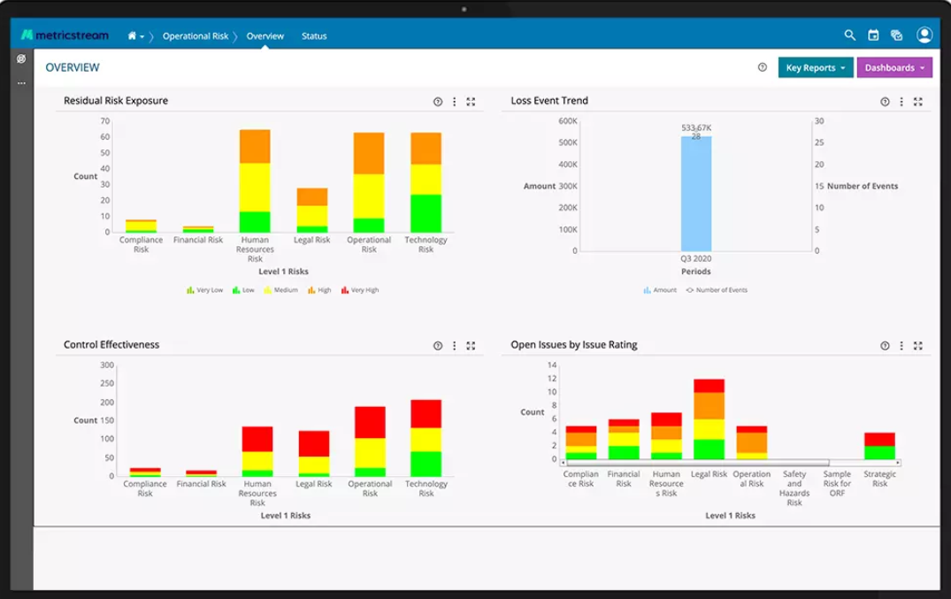
MetricStream Risk Visualizations^{(a)}
Notes:
Tools such as MetricStream offer visualizations so these risks can be seen in context to each other and in real time. This dashboard shows different categories of Residual Risk Exposure, as this sample company defined, compliance risk, financial risk, human resources risk, legal risk, operational risk, and technology risk, in the top left. This shows an example of what areas may be deemed the highest risks overall, which ones have greater levels of certain risks, and in the bottom left corner, this company has a visualization to show the effectiveness of their mitigation efforts.

Slide 10
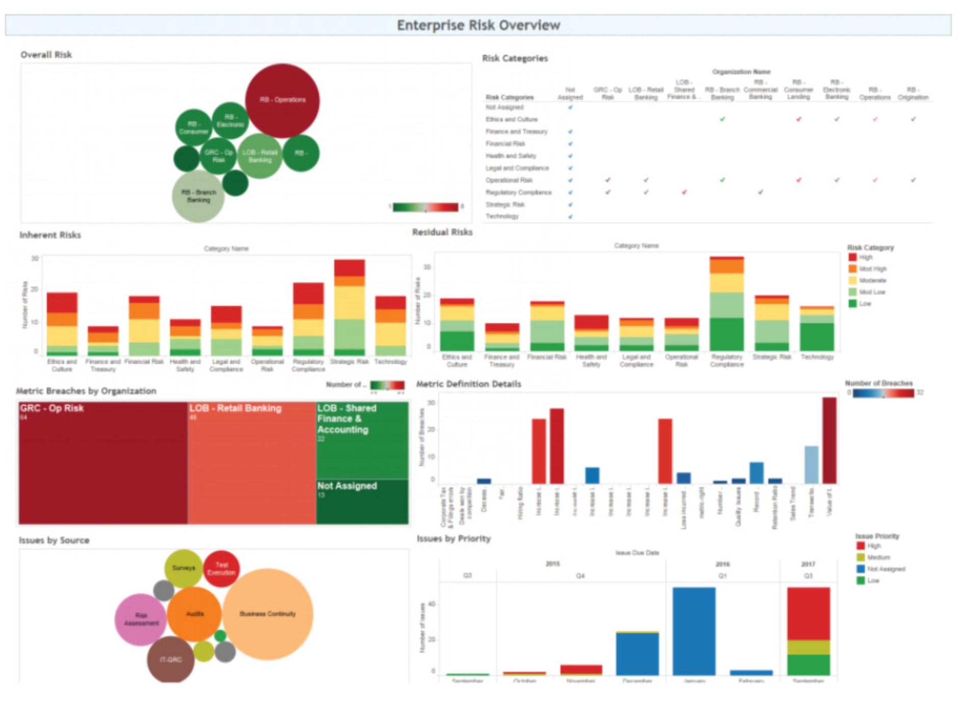
MetricStream Risk Visualizations^{(b)}
Notes:
One of the benefits of utilizing data analytics is the depth of the insights and the ability to make the most efficient use of resources. This is another dashboard created with MetricStream, which can perform the analysis as well as create these visuals, showing the greatest overall risk, as in this top left image. The largest and most red circle indicating the greatest overall risk. In the bottom left, the largest circle indicates the greatest source of this example’s risk, which is business continuity.
These tools also allow for a deeper dive into the data, should more specific information be desired. So, clicking on the bar for Q1 in 2017 in the chart on the bottom right will “drill-through” or bring us to more detailed information about the issues.

Slide 11
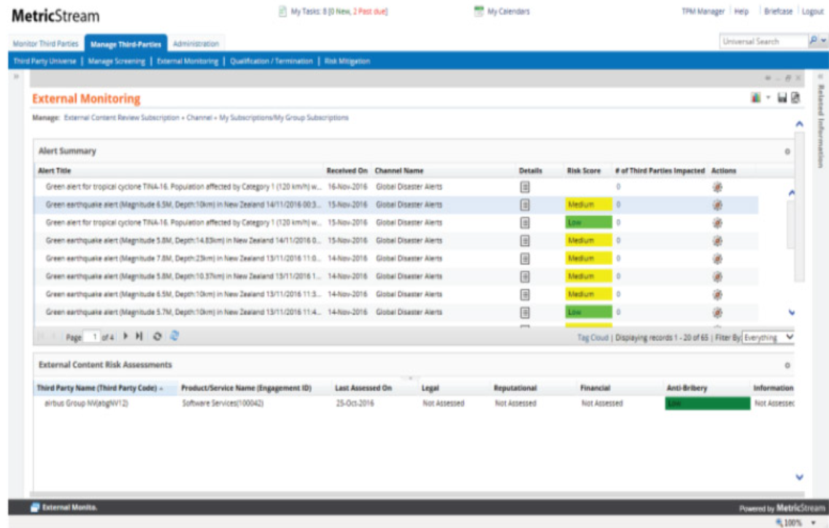
MetricStream Risk Visualizations^{(c)}
Notes:
And to take it in a concise, simplified direction, individualized views that highlight the specific area, and a general risk score, highlighted by the corresponding color allows a quick and easy read of the issue and the basic information that may be needed, with the opportunity to drill-through to greater detail by clicking on a specific item to bring up greater detail, like shown in the bottom half of this box.

Slide 12
Summary
Build comprehensive operational framework
Data collection
Internal loss
External loss
Risk and control self-assessment
Rate risks
Macro/Micro
Tools for monitoring, analyzing, and visualization, such as MetricStream
Notes:
So, to best support Company XYZ in meeting their goals, we will build a comprehensive operational framework with the solid foundation that addresses the four areas of data collection, internal loss, external loss, and risk and control self-assessment.
The risks will be rated so as to identify the higher priority and higher risk overall as a combination of the likelihood and magnitude of loss.
And tools for monitoring, analyzing, and visualizing the data and risk will be implemented, such as those seen here from MetricStream.

Slide 13
References
1. Girling, P. (2013). Operational Risk Management: A Complete Guide to a Successful Operational Risk Framework (1st ed.) [E-book]. Wiley.
2. Camac, K. (2022, September 30). Module 7 Scenario Analysis [Online forum post]. SNHU.edu. Retrieved October 9, 2022, from https://learn.snhu.edu/d2l/lms/news/main.d2l?ou=1145647
3. Maverick, J. B. (2021, July 30). What Are the Major Categories of Financial Risk for a Company? Investopedia. Retrieved October 9, 2022, from https://www.investopedia.com/ask/answers/062415/what-are-major-categories-financial-risk-company.asp
4. Joyce, N. (2021, October 25). Operational Risk. CFA, FRM, and Actuarial Exams Study Notes. Retrieved October 9, 2022, from https://analystprep.com/study-notes/frm/part-1/valuation-and-risk-management/operational-risk/
Visualizations from:
a. Enterprise and Operational Risk Management. (n.d.). Metricstream. Retrieved October 9, 2022, from https://www.metricstream.com/products/enterprise-and-operational-risk.htm
b. & c. 2017 MetricStream Labs Report: From M7 to the GRC of Everything. (n.d.). Metricstream. Retrieved October 9, 2022, from https://www.metricstream.com/whitepapers/MetricStream-Labs-Report-2017.htm

Slide 14
Contact information:
Tricia M. Lang, MA, LPC
Tricia.Lang@snhu.edu
203-507-8431
Notes:
Are there any questions or comments?
If after this presentation there are any questions, please do not hesitate to reach out. My information is included here if anything comes to mind after you have had a chance to process all of this information.
Thank you so much for your time and attention.
Hope you all have a great day.

